Slide 1

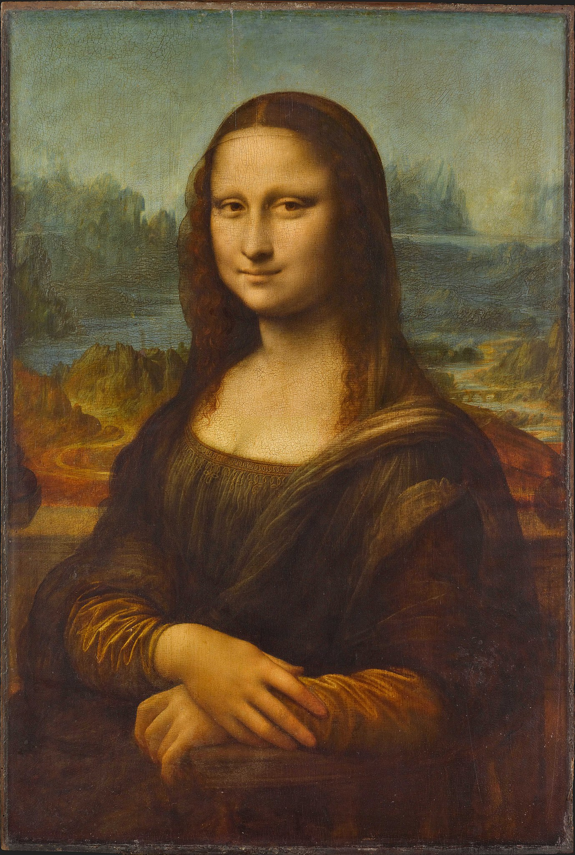


Slide 2
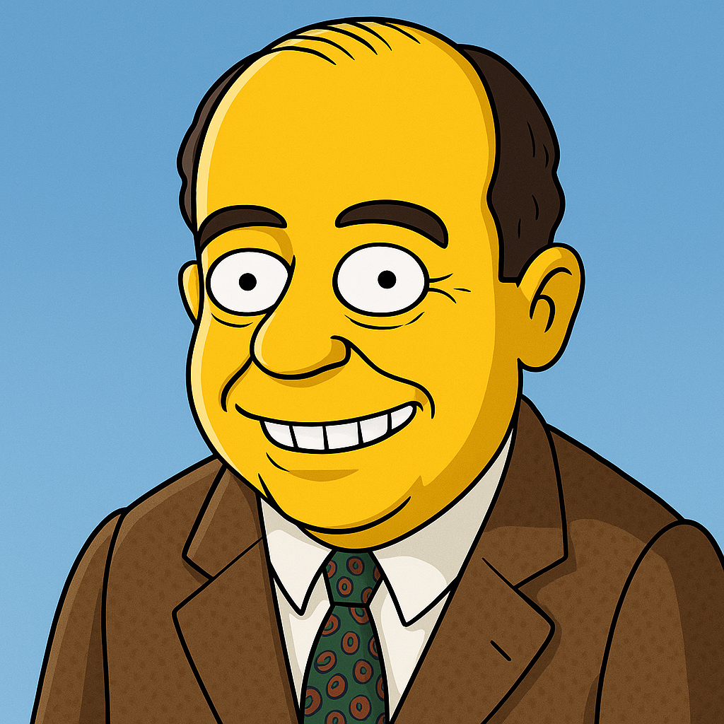

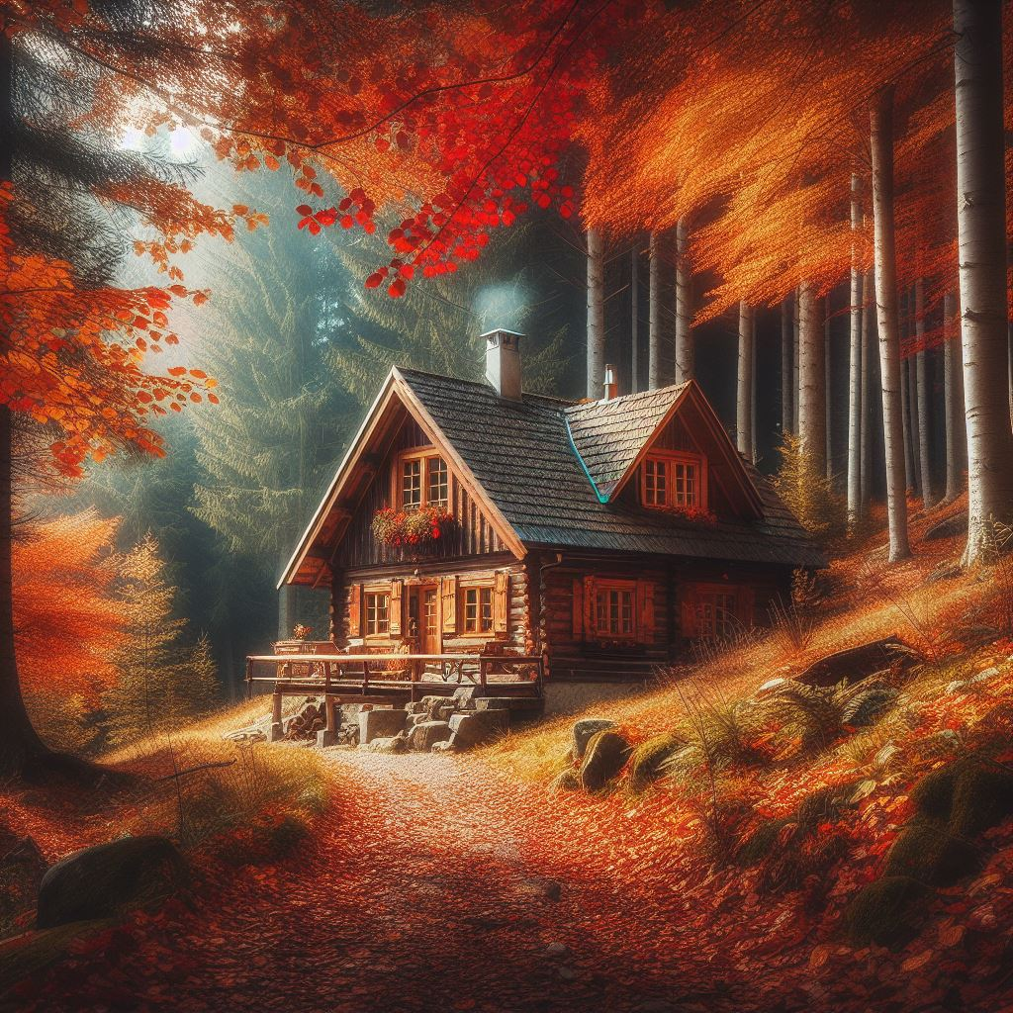

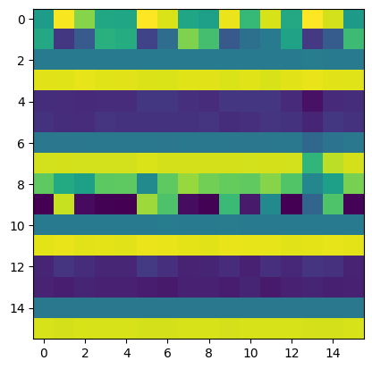

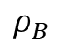
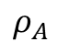
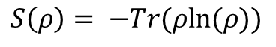
Entanglizer 9000 with QPIXL
We quantum-crammed two images, bribed it with von Neumann entropy, and it rewarded us with a beautifully entangled photonic lovechild.
J. Von Neumann
Entropy maximization
$$ρ_{A}$$
$$S\left(ρ\right)= −Tr(ρln⁡(ρ))$$
$$ρ_{B}$$

Slide 3
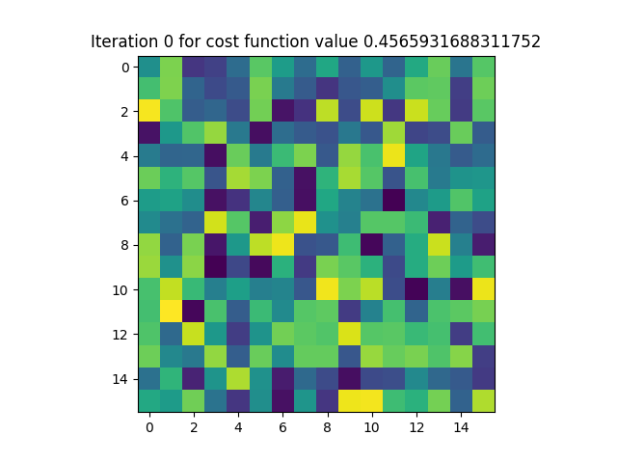
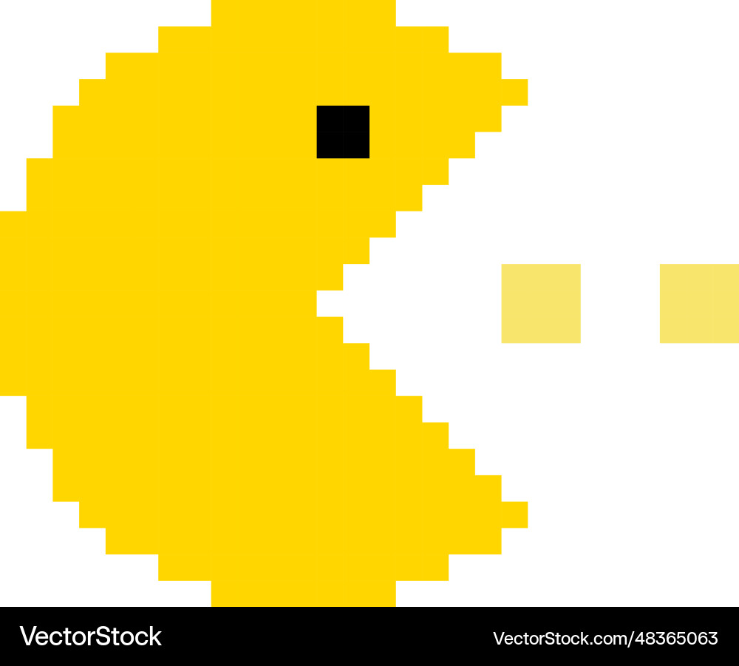

Quantum Image Compilation
Kill Pacman retrieve the Ghost
Methodologies:
SWAP test
Real overlap test
Hong Ou Mandel effect
Variational Optimization

Slide 4
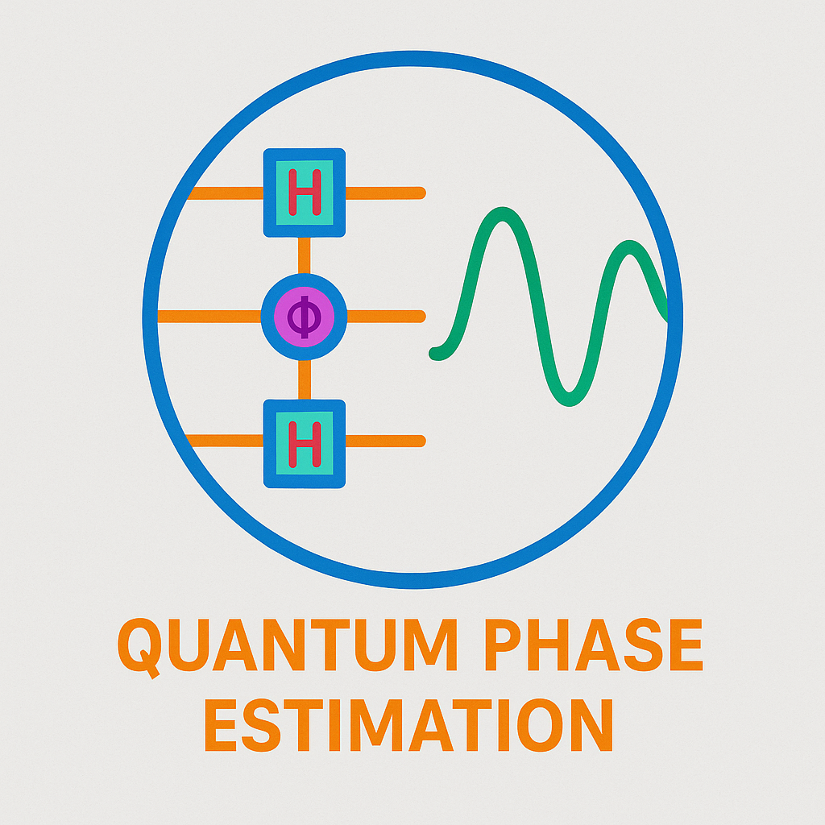

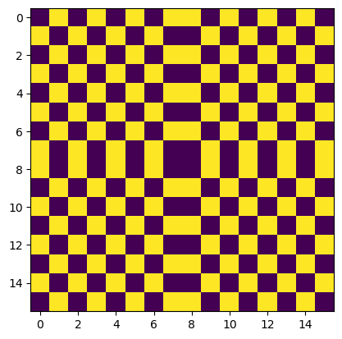
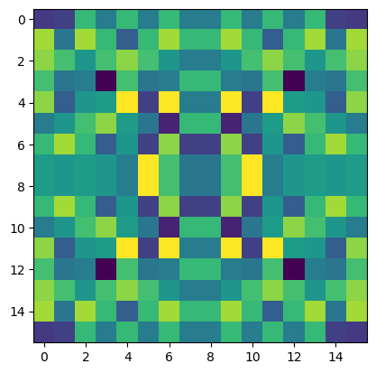
Quantum Phase Estimation 4 QPIXL
Exploit entanglement, discover the angle and generate your Quantum Image
Entanglement
QPE
QPIXL
Use our interactive cell to add your image to our collection!
Your Image

Slide 5

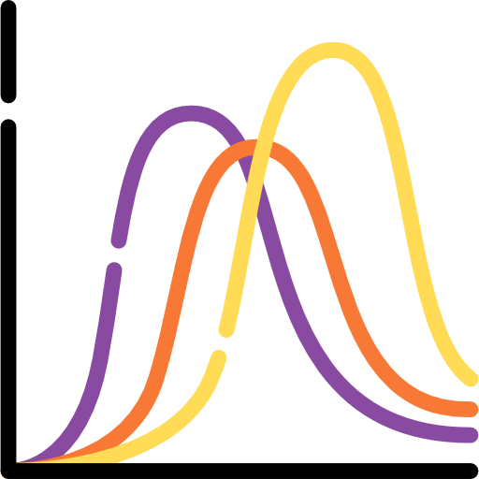
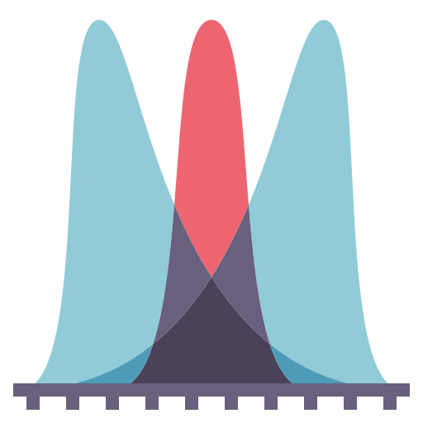
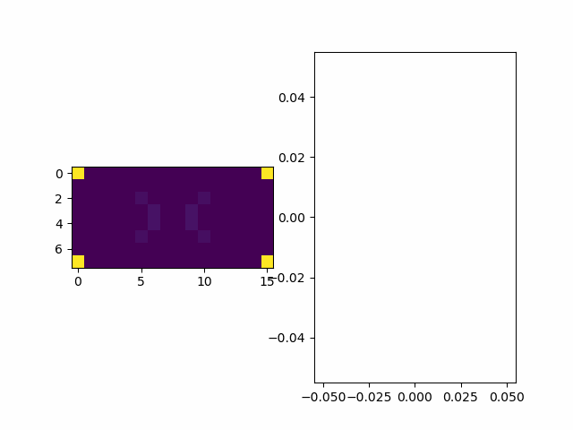
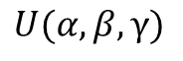
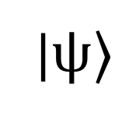
Variational Quantum Algorithm 4 QPIXL
Follow your favourite probability distribution and visualize how VQAs Learn
|$ψ⟩$
$$U(α,β,γ)$$
Play with the Notebook to discover new examples

Slide 6
THANK YOU for the experience!
REPO: https://github.com/franz3105/QPIXL_IT_2025_QBusters

